Slide 1
Predictive Model for Neonatal Sepsis Detection
Sara Allali

Slide 2
Agenda
Motivation & Problem (01)
Data Overview (02)
Modeling Approach (03)
Modeling Architecture (04)
Performance & Results (05)
Conclusion (06)

Slide 3
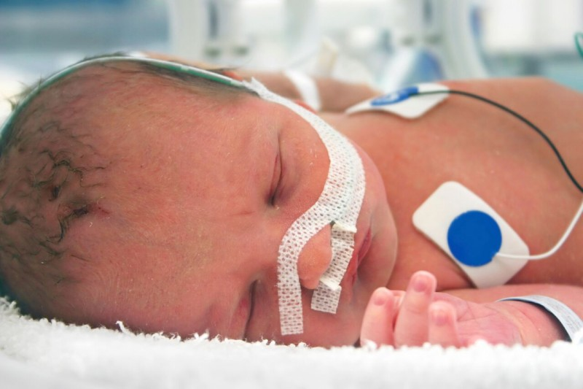
Motivation and Problem Statement
High burden of disease
• ~2,800 cases per 100,000 live births globally
• Mortality ~17.6%, higher in preterm & low-birth-weight infants
Limitations of current diagnostics
• Blood culture = gold standard, but slow (48-72 hrs)
• Low sensitivity; many culture-negative cases
• Leads to widespread empiric antibiotic use
Need for innovation
• Early, reliable prediction models can:
– Enable faster treatment decisions
– Reduce unnecessary antibiotic use
– Improve neonatal survival & outcomes
Clinical challenges
• Delayed diagnosis → higher risk of death & complications
• Overtreatment → antibiotic resistance & adverse effects

Slide 4
Data Overview and Scope
Data Source: MIMIC-III Clinical Database (PhysioNet)
Cohort: Neonates admitted to or discharged from the NICU (~7,992 patients)
Variables Collected:
Demographics: Gender, date of birth, ethnicity, age at discharge
Labs: Platelets, WBC, Hemoglobin, C-Reactive Protein, BUN, Creatinine, Albumin
Clinical Features: Birthweight, gestational age, total medications, length of stay, mortality, positive blood culture
Target Variable for Prediction: Positive blood culture (neonatal sepsis)
Data Characteristics:
Mix of continuous and categorical variables
Some class imbalance in outcome variable (few positives, many negatives)

Slide 5
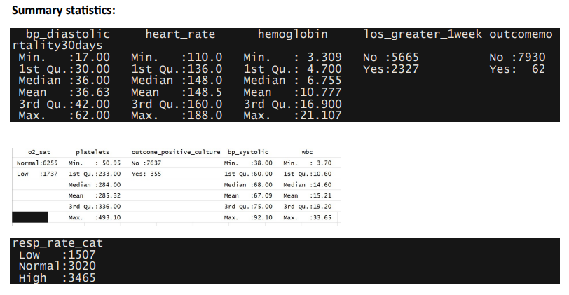
Data Retrieval and Preparation
Cohort Selection: Filtered NICU patients using first_careunit or last_careunit = NICU
SQL Highlights:
Used CTEs (WITH statements) to create temporary datasets for cohort, demographics, labs
INNER JOIN to combine patient and admission info
LEFT OUTER JOIN to retain cohort members even with missing demographics
ROW_NUMBER() with partitioning to select first admission/lab values
Handling Missing/Repeated Data:
Selected first valid lab entries per patient
Partitioned admissions by patient and admission time

Slide 6
Modeling Approach
Objective:
Predict positive blood culture (neonatal sepsis) using demographic, clinical, and laboratory data.
Outcome Variable:
Binary classification: outcome_positive_culture (1 = Positive, 0 = Negative).
Predictors / Features:
Demographics: Age at discharge, gender, ethnicity, birthweight, gestational age.
Clinical indicators: Vital signs (heart rate, blood pressure, respiratory rate).
Laboratory values: Platelet count, WBC, hemoglobin, CRP, BUN, creatinine, albumin.
Other: Total medications administered, length of stay.

Slide 7
Modeling Approach
Model Choice:
Extreme Gradient Boosting (XGBoost):
Handles nonlinear relationships and feature interactions.
Well-suited for tabular clinical datasets.
Handling Class Imbalance:
Dataset is imbalanced: 355 positive vs 7,637 negative cases.
Applied SMOTE (Synthetic Minority Over-sampling Technique) to improve model’s ability to detect negative cases.
Validation Strategy:
Cross-validation (10-fold) for unbiased performance estimation.
Performance metrics include ROC, sensitivity, specificity, and accuracy.

Slide 8
Model Architecture
Why XGBoost:
High-performing gradient boosting algorithm, ideal for tabular data and handling complex feature interactions
Model Structure & Design Choices:
Algorithm: xgbTree (gradient boosted decision trees)
Tree Depth (max_depth): 3–5 – balances complexity vs generalization
Number of Boosting Rounds (nrounds): 100 – sufficient iterations for learning
Learning Rate (eta): 0.1–0.3 – controls step size to avoid overfitting
min_child_weight: 1 – ensures meaningful splits
Subsample & colsample_bytree: 1 – use all rows/features per tree for robust learning
Training Setup & Rationale:
Data Split: 60% Train / 20% Validation / 20% Test
Cross-Validation: 10-fold CV – ensures model stability and robust hyperparameter tuning
Class Imbalance Handling: SMOTE applied to improve minority class learning
Optimization Metric: ROC/AUC – prioritizes discrimination for imbalanced classes

Slide 9
Baseline Performance
Validation ROC: 0.93 → strong ability to distinguish positive vs. negative cases
Sensitivity: 99.8% → excellent at detecting true positive sepsis cases
Specificity: 33.2% → weak at identifying true negatives due to class imbalance
Impact of SMOTE (oversampling)
Specificity improved to 40.1% → better recognition of negative cases
ROC decreased to 0.86
Sensitivity dropped to 95.6%
Accuracy: 93.4%
Key Insights
Trade-off observed: balancing sensitivity vs. specificity under severe class imbalance
Model is highly reliable at identifying positive sepsis cases but struggles with negatives
SHAP analysis confirms nonlinear feature effects and highlights influential predictors
Model Performance

Slide 10
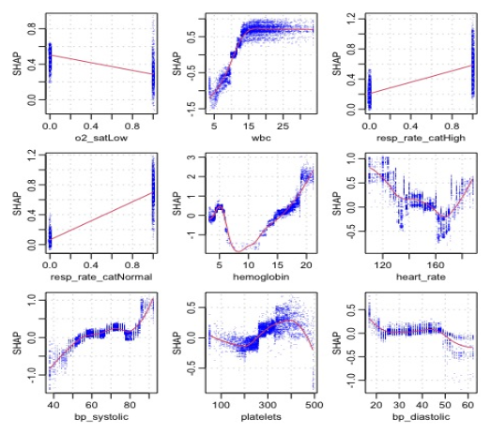
Model Interpretability (SHAP Analysis)
Method: SHAP (SHapley Additive Explanations) applied to XGBoost model.
Purpose: Quantify each feature’s contribution to prediction outcomes.
Findings:
Exposed nonlinear relationships across vitals and labs (e.g., thresholds where risk increases sharply).
Provided patient-level explanations (local interpretability) → essential for clinical decision support.
Value: Enhances transparency, builds clinician trust, and identifies high-impact predictors for neonatal sepsis.

Slide 11
Key Feature Insights
Top Predictors Identified:
Hemoglobin → lower ranges strongly associated with positive sepsis cultures.
Heart Rate → elevated rates increased predicted risk.
Respiratory Rate (categorical) → “High” category significantly linked to sepsis cases.
Diastolic Blood Pressure → abnormal values contributed meaningfully to predictions.
Clinical Implications:
Highlights importance of vital signs and lab values as early sepsis indicators.
SHAP clarified how each feature drives risk, supporting explainable AI in healthcare.
Feature-level insights can guide further data collection & clinical validation.

Slide 12

Conclusion
Data imbalance: negative cases heavily outweighed positives.
Specificity trade-off: improving negative detection reduced overall ROC and sensitivity.
Limited external validation; results tied to current dataset.
Limitations
Model shows strong sensitivity (99.8%) and high ROC (0.93), meaning it effectively identifies true positive sepsis cases.
Specificity remains limited (33.2% → 40.1% with SMOTE), showing challenges in correctly classifying true negatives.
SHAP analysis highlighted key clinical indicators (vitals, labs) driving predictions.
Explore alternative resampling methods beyond SMOTE (e.g., ADASYN, cost-sensitive learning).
Incorporate additional clinical features to boost negative case detection.
Apply model fine-tuning & ensemble approaches for better balance across metrics.
Validate model performance in real-world neonatal settings before clinical use.
Future Directions
Main Takeaways
Early sepsis prediction is achievable with high sensitivity, but improving specificity and clinical reliability is the key next step. With further refinement, this approach could support faster diagnosis, better treatment decisions, and improved outcomes for vulnerable newborns.

Slide 13
Thank you

